Slide 1
Chapter 15.6-15.9
Elliptic curve cryptography and pairings

Slide 2
Outline
Advanced encryption schemes from pairings
The functional encryption paradigm
Multilinear map

Slide 3
Advanced encryption schemes from pairings

Slide 4
Identity based encryption
Core Concept: What Problem Does It Solve?
  In traditional public-key cryptography:
  If Alice wants to encrypt a message to Bob, she must first obtain Bob's current public key.
  She must query this key using a certificate or public key directory, which typically requires an additional round of communication.
IBE's goals:
  Eliminate this initial round of communication.
  Allow any string (e.g., Bob's email address, the current date, or the numbers 1, 2, or 3) to serve as a public key.

Slide 5
Identity based encryption
How it works ?
Tracy(private key generator)
Id:Alice@gmail.com
mpk
S()=(mpk,msk)
sk_id=G(msk,id)
Alice
c
Bob
m=D(sk_id,c)
c=E(mpk,id,m)

Slide 6
Formal definition
algor | input | output | explain
S | - | (mpk, msk) | Generate the system's master key pair
G | (msk, id) | sk_id | Generate a private key for a specific identity id
E | (mpk, id, m) | c | Use identity id to encrypt message m
D | (sk_id, c) | m or reject | Decrypt ciphertext c using sk_id

Slide 7
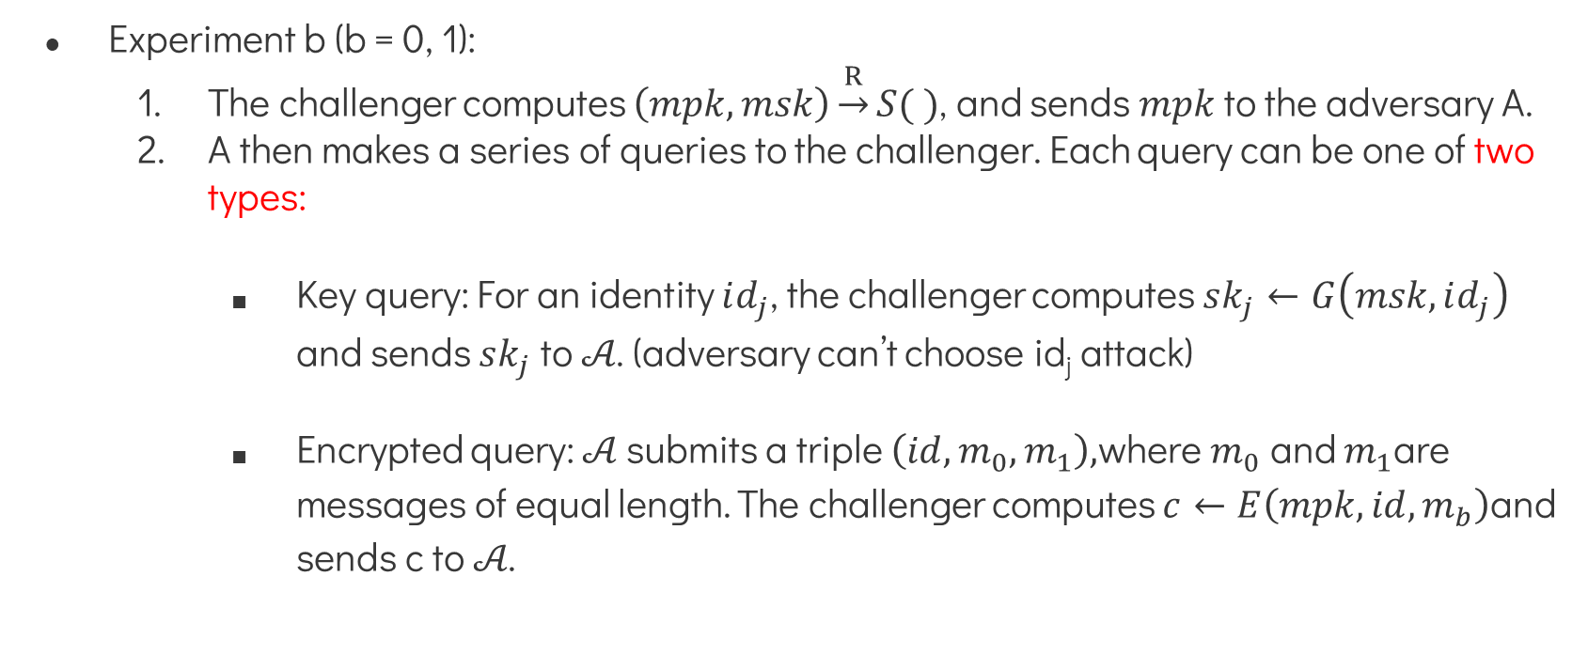
Attack Game
Experiment b (b = 0, 1):
  The challenger computes $\left(mpk,msk\right)\underset{→}{R}S( )$, and sends $mpk$ to the adversary A.
  A then makes a series of queries to the challenger. Each query can be one of two types:
    Key query: For an identity $id_{j}$, the challenger computes $sk_{j}←G\left(msk,id_{j}\right)$ and sends $sk_{j}$ to 𝒜. (adversary can’t choose id_{j} attack)
    Encrypted query: 𝒜 submits a triple $\left(id,m_{0},m_{1}\right),$where $m_{0}$ and $m_{1}$are messages of equal length. The challenger computes $c←E\left(mpk,id,m_{b}\right)$and sends c to 𝒜.

Slide 8
Attack Game
  Limitations:
    The adversary cannot perform a key query on the ID used in the encrypted query. Otherwise, the adversary could simply decrypt the data using the private key and easily win the game.
  Guess: Eventually, the adversary outputs a bit b' as its guess about b.

Slide 9
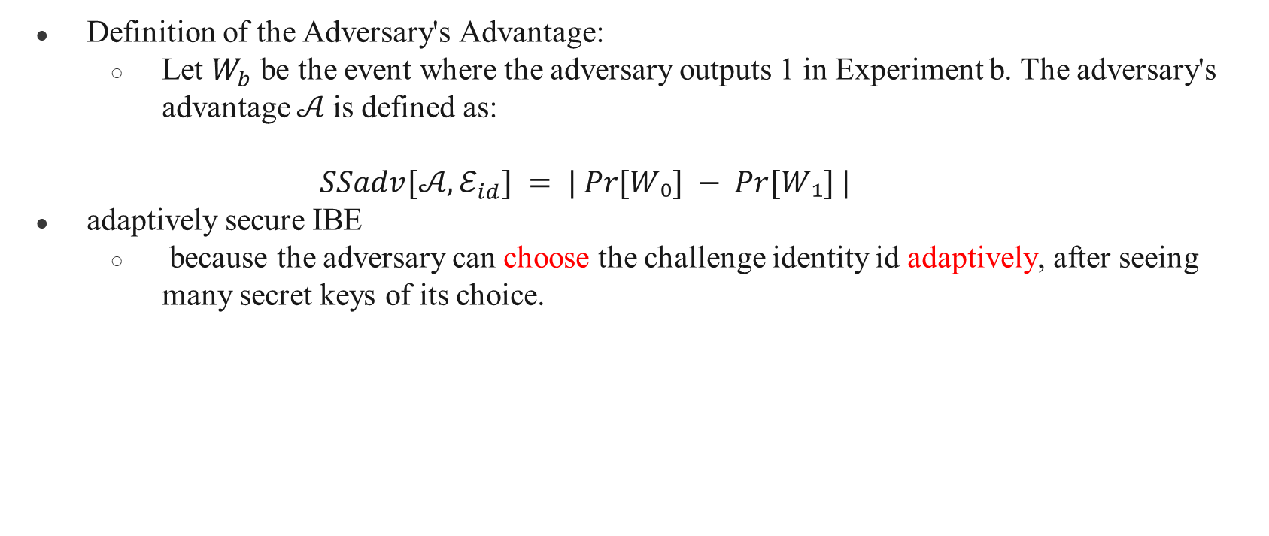
Attack Game
Definition of the Adversary's Advantage:
  Let $W_{b}$ be the event where the adversary outputs 1 in Experiment b. The adversary's advantage 𝒜 is defined as:
  $$SSadv[𝒜, ℰ_{id}] = | Pr⁡[W₀] − Pr⁡[W₁] |$$
adaptively secure IBE
  because the adversary can choose the challenge identity id adaptively, after seeing many secret keys of its choice.

Slide 10
Related security notions
After defining basic semantic security (adaptive security), the document introduces three important related security concepts:
  Privacy (IBE)
  Selective Security (IBE)
  Selective Ciphertext Security (IBE)

Slide 11
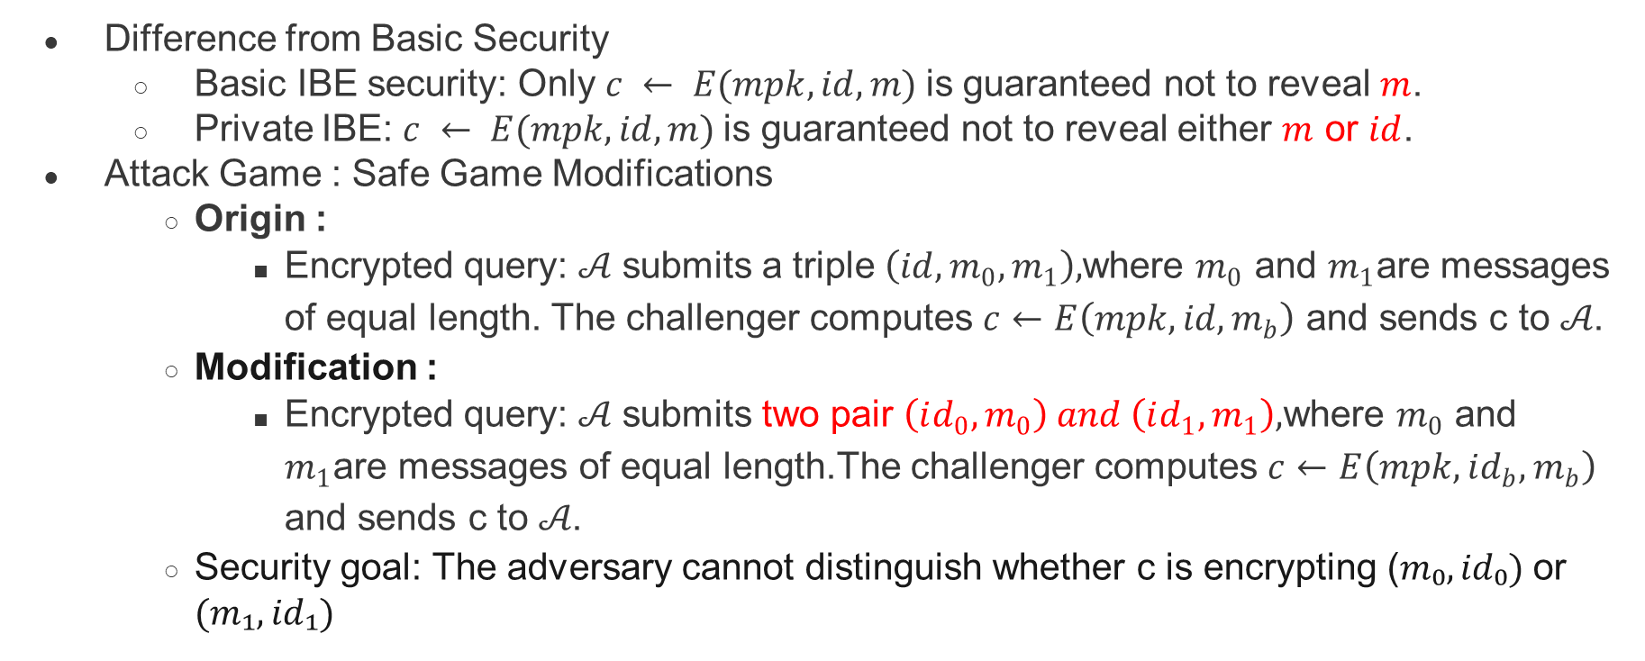
Related security notions──Privacy (IBE)
Difference from Basic Security
  Basic IBE security: Only $c ← E(mpk, id, m)$is guaranteed not to reveal $m$.
  Private IBE: $c ← E(mpk, id, m)$is guaranteed not to reveal either $m$ or $id$.
Attack Game : Safe Game Modifications
  Origin :
    Encrypted query: 𝒜 submits a triple $\left(id,m_{0},m_{1}\right),$where $m_{0}$ and $m_{1}$are messages of equal length. The challenger computes $c←E\left(mpk,id,m_{b}\right)$ and sends c to 𝒜.
  Modification :
    Encrypted query: 𝒜 submits two pair $\left(id_{0},m_{0}\right) and \left(id_{1},m_{1}\right),$where $m_{0}$ and $m_{1}$are messages of equal length.The challenger computes $c←E\left(mpk,id_{b},m_{b}\right)$ and sends c to 𝒜.
  Security goal: The adversary cannot distinguish whether c is encrypting ($m₀,id₀)$or $(m₁,id₁)$

Slide 12
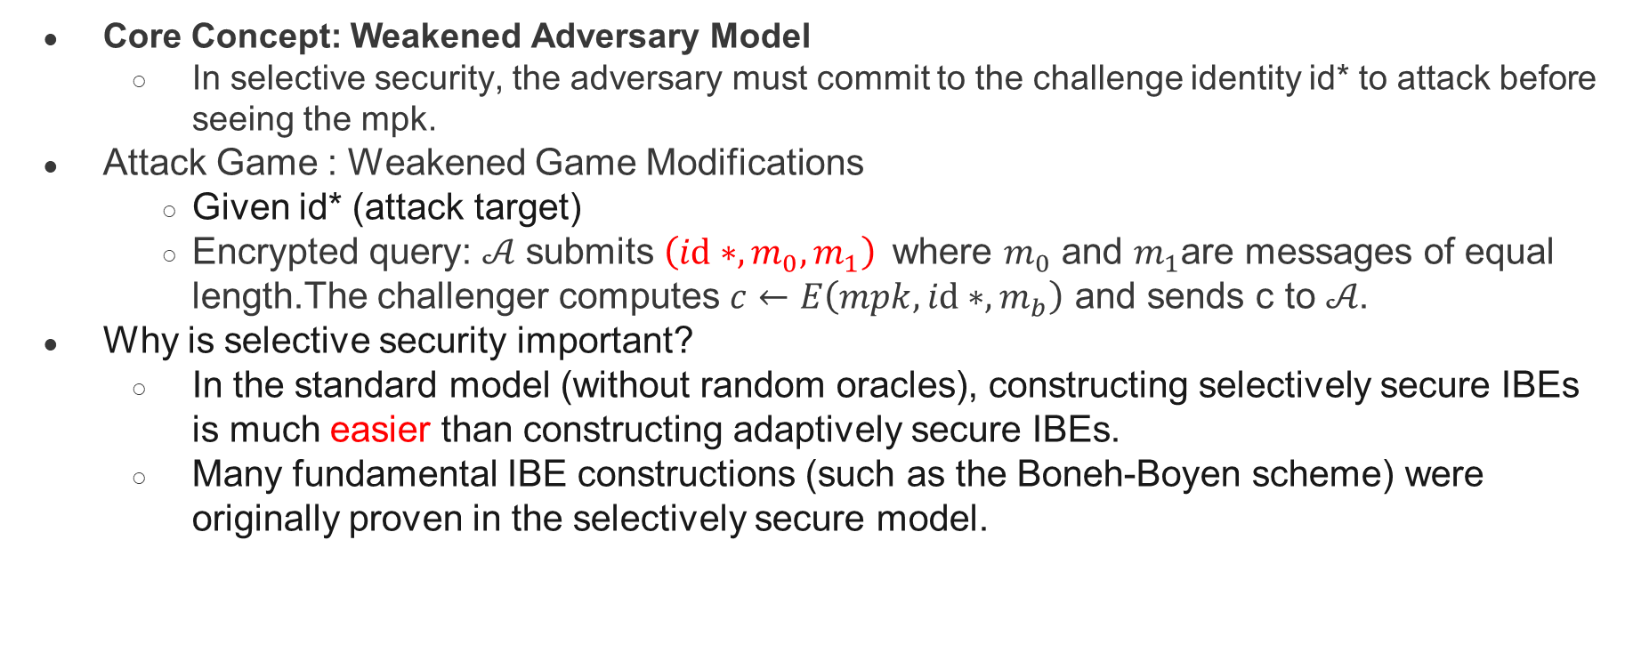
Related security notions──Selective Security (IBE)
Core Concept: Weakened Adversary Model
  In selective security, the adversary must commit to the challenge identity id* to attack before seeing the mpk.
Attack Game : Weakened Game Modifications
  Given id* (attack target)
  Encrypted query: 𝒜 submits $\left(id∗,m_{0},m_{1}\right)$where $m_{0}$ and $m_{1}$are messages of equal length.The challenger computes $c←E\left(mpk,id∗,m_{b}\right)$ and sends c to 𝒜.
Why is selective security important?
  In the standard model (without random oracles), constructing selectively secure IBEs is much easier than constructing adaptively secure IBEs.
  Many fundamental IBE constructions (such as the Boneh-Boyen scheme) were originally proven in the selectively secure model.

Slide 13
Related security notions──Selective Security (IBE)
Transitioning to Adaptive Security
  Using a hash function H: 𝒟′ → 𝒟:
  G′(msk, id) = G(msk, H(id))
  E′(mpk, id, m) = E(mpk, H(id), m)
  This maps the identity space from 𝒟′ to 𝒟, achieving adaptive security in the random oracle model.

Slide 14
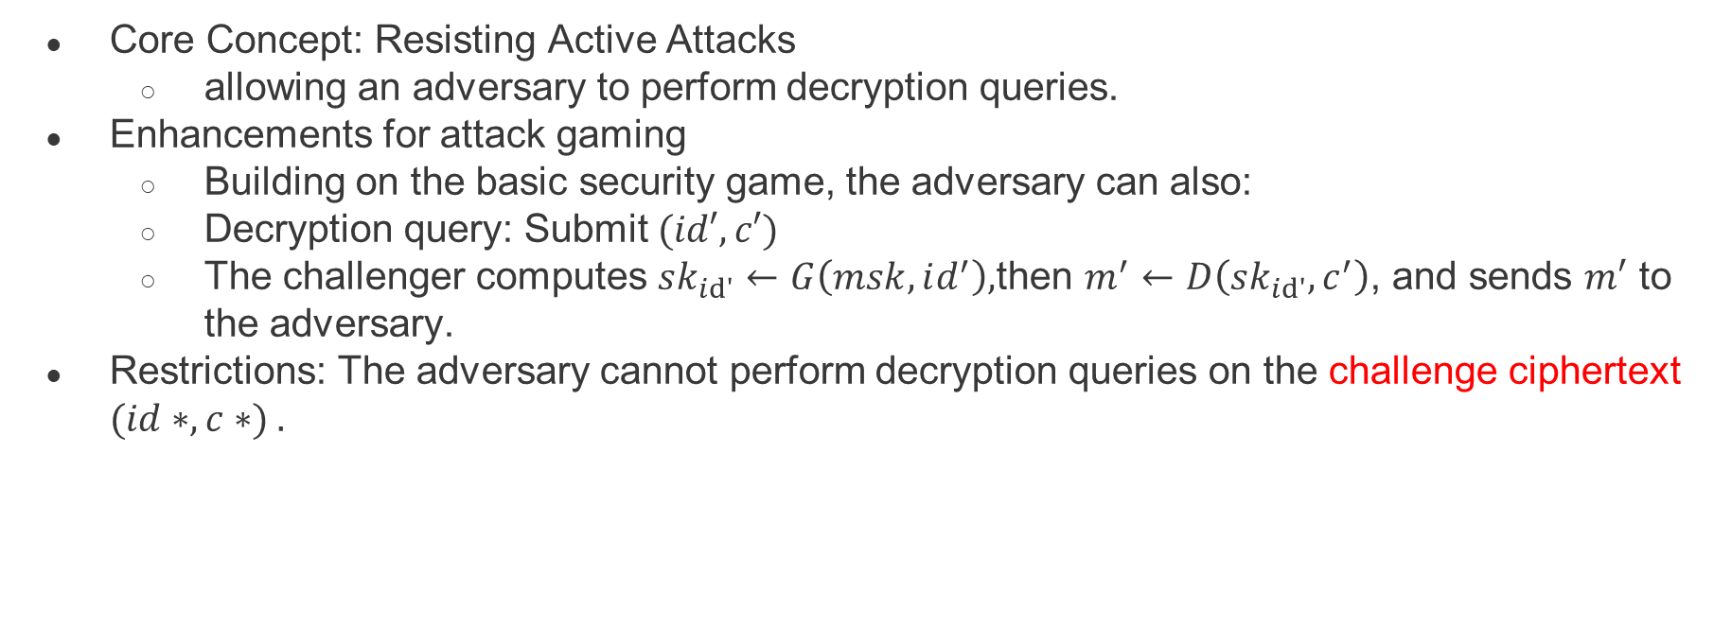
Related security notions──Chosen-ciphertext secure IBE
Core Concept: Resisting Active Attacks
  allowing an adversary to perform decryption queries.
Enhancements for attack gaming
  Building on the basic security game, the adversary can also:
  Decryption query: Submit $(id′, c′)$
  The challenger computes $sk_{id′}←G\left(msk,id^{′}\right),$then $m^{′}←D\left(sk_{id′},c^{′}\right)$, and sends $m′$ to the adversary.
Restrictions: The adversary cannot perform decryption queries on the challenge ciphertext $(id∗, c∗) .$

Slide 15
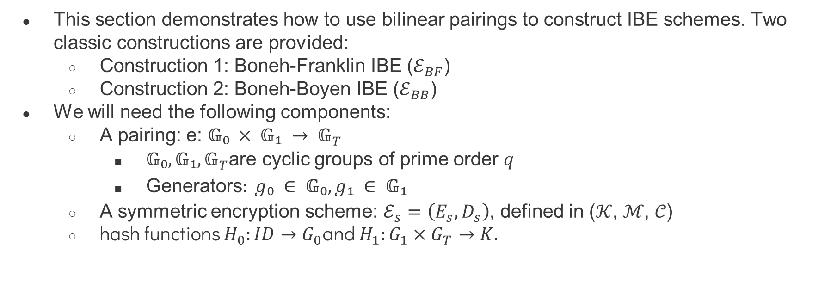
Identity based encryption from pairings
This section demonstrates how to use bilinear pairings to construct IBE schemes. Two classic constructions are provided:
  Construction 1: Boneh-Franklin IBE ($ℰ_{BF}$)
  Construction 2: Boneh-Boyen IBE ($ℰ_{BB}$)
We will need the following components:
  A pairing: e:
    are cyclic groups of prime order $q$
    Generators$: g₀ ∈ 𝔾₀, g₁ ∈ 𝔾₁$
  A symmetric encryption scheme: $ℰ_{s}=\left(E_{s},D_{s}\right)$, defined in (𝒦, ℳ, 𝒞)
  hash functions $H_{0}:ID→G_{0}$and $H_{1}:G_{1}×G_{T}→K.$

Slide 16
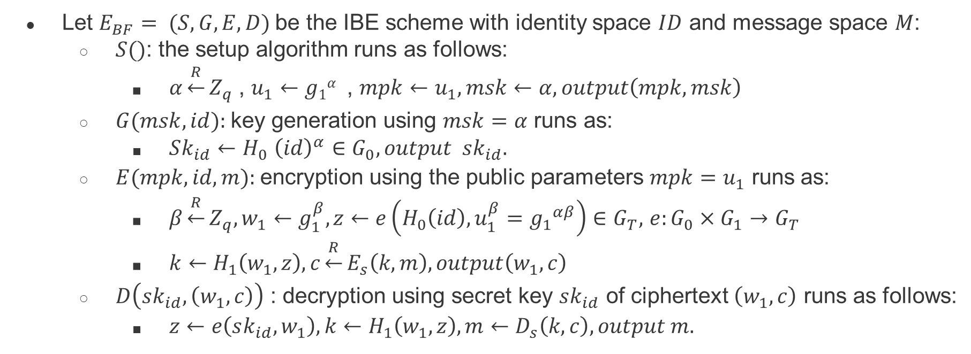
Identity based encryption from pairings ───Construction 1
Let $E_{BF}= (S, G, E, D)$be the IBE scheme with identity space $ID$ and message space $M$:
  $S()$: the setup algorithm runs as follows:
    $α\underset{←}{R}Z_{q}$ , $u_{1}←g1α$ , $mpk←u_{1},msk←α,output\left(mpk,msk\right)$
  $G(msk, id):$key generation using $msk=α$ runs as:
    $Sk_{id}{←H}_{0}{\left(id\right)}^{α}∈G_{0},output sk_{id}.$
  $E(mpk, id, m):$encryption using the public parameters $mpk=u_{1}$ runs as:
    $β\underset{←}{R}Z_{q},w_{1}←g_{1}^{β},z←e\left(H_{0}\left(id\right),u_{1}^{β}={g_{1}}^{αβ}\right)∈G_{T},$ $e:G_{0}​×G_{1}​→G_{T}​$
    $k←H_{1}\left(w_{1},z\right),c\underset{←}{R}E_{s}\left(k,m\right),output\left(w_{1},c\right)$
  $D\left(sk_{id},\left(w_{1},c\right)\right)$ : decryption using secret key $sk_{id}$ of ciphertext $\left(w_{1},c\right)$ runs as follows:
    $z←e\left(sk_{id},w_{1}\right),k←H_{1}\left(w_{1},z\right),m←D_{s}\left(k,c\right),output m.$

Slide 17
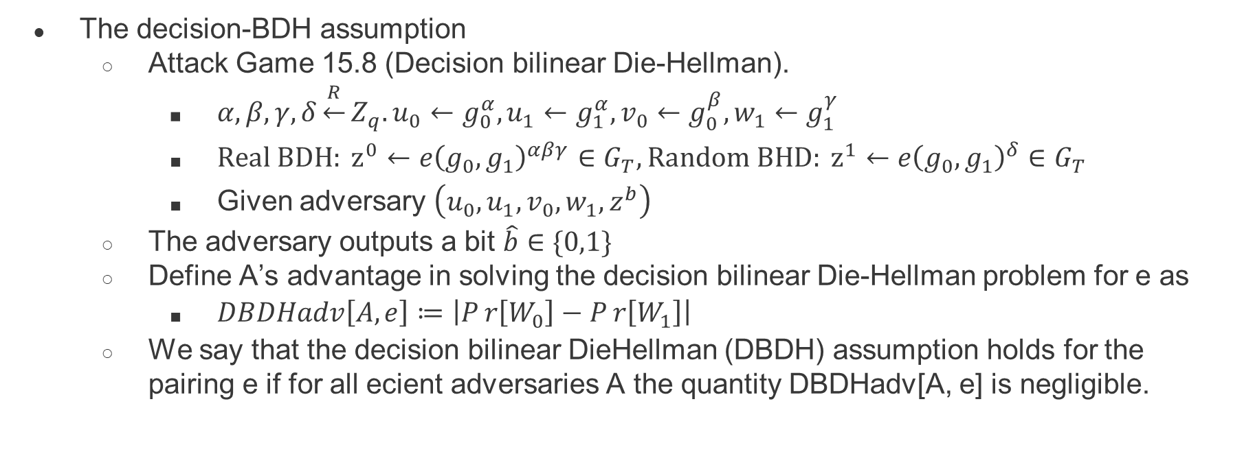
Identity based encryption from pairings ───Construction 1
The decision-BDH assumption
  Attack Game 15.8 (Decision bilinear Die-Hellman).
    $α,β,γ,δ\underset{←}{R}Z_{q}.u_{0}←g_{0}^{α},u_{1}←g_{1}^{α},v_{0}←g_{0}^{β},w_{1}←g_{1}^{γ}$
    $Real BDH: z^{0}←e{\left(g_{0},g_{1}\right)}^{αβγ}∈G_{T},Random BHD: z^{1}←e{\left(g_{0},g_{1}\right)}^{δ}∈G_{T}$
    Given adversary $\left(u_{0},u_{1},v_{0},w_{1},z^{b}\right)$
  The adversary outputs a bit $\hat{b}∈\{0,1\}$
  Define A’s advantage in solving the decision bilinear Die-Hellman problem for e as
    $DBDHadv\left[A,e\right]≔\left|Pr\left[W_{0}\right]−Pr\left[W_{1}\right]\right|$
  We say that the decision bilinear DieHellman (DBDH) assumption holds for the pairing e if for all ecient adversaries A the quantity DBDHadv[A, e] is negligible.

Slide 18
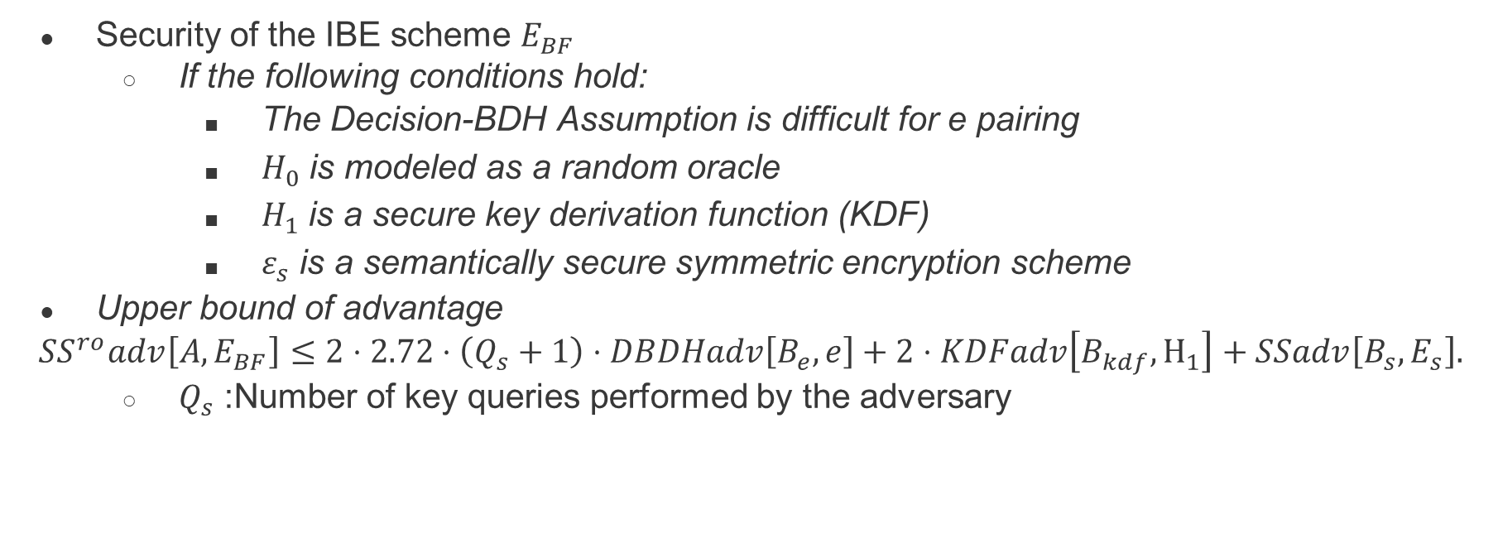
Identity based encryption from pairings ───Construction 1
Security of the IBE scheme $E_{BF}$
  If the following conditions hold:
    The Decision-BDH Assumption is difficult for e pairing
    $H_{0}$ is modeled as a random oracle
    $H_{1}$ is a secure key derivation function (KDF)
    $ε_{s}$ is a semantically secure symmetric encryption scheme
Upper bound of advantage
$$SS^{ro}adv\left[A,E_{BF}​\right]≤2⋅2.72⋅\left(Q_{s}​+1\right)⋅DBDHadv\left[B_{e}​,e\right]+2⋅KDFadv\left[B_{kdf}​,H_{1}\right]+SSadv\left[B_{s}​,E_{s}​\right].$$
  $Q_{s}$ :Number of key queries performed by the adversary

Slide 19
Identity based encryption from pairings ───Construction 1 ─── Proof
Steps
  Starting with a real game: An adversary attacks a practical IBE scheme.
  Substituting the challenge ciphertext: Replace z in the challenge ciphertext with a random value.
  Substituting the symmetric key: Replace the output of the key derivation with a random key.
  Exploiting symmetric encryption security: The adversary's advantage ultimately stems from the security of symmetric encryption.

Slide 20
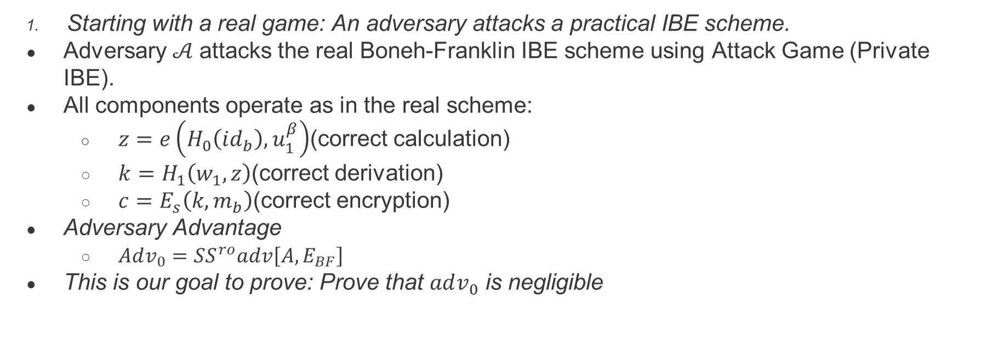
Identity based encryption from pairings ───Construction 1 ─── Proof
Starting with a real game: An adversary attacks a practical IBE scheme.
Adversary 𝒜 attacks the real Boneh-Franklin IBE scheme using Attack Game (Private IBE).
All components operate as in the real scheme:
  $z=e\left(H_{0}\left(id_{b}\right),u_{1}^{β}\right)$(correct calculation)
  $k=H_{1}\left(w_{1},z\right)$(correct derivation)
  $c=E_{s}\left(k,m_{b}\right)$(correct encryption)
Adversary Advantage
  $Adv_{0}​=SS^{ro}adv\left[A,E_{BF}​\right]$
This is our goal to prove: Prove that $adv_{0}$ is negligible

Slide 21
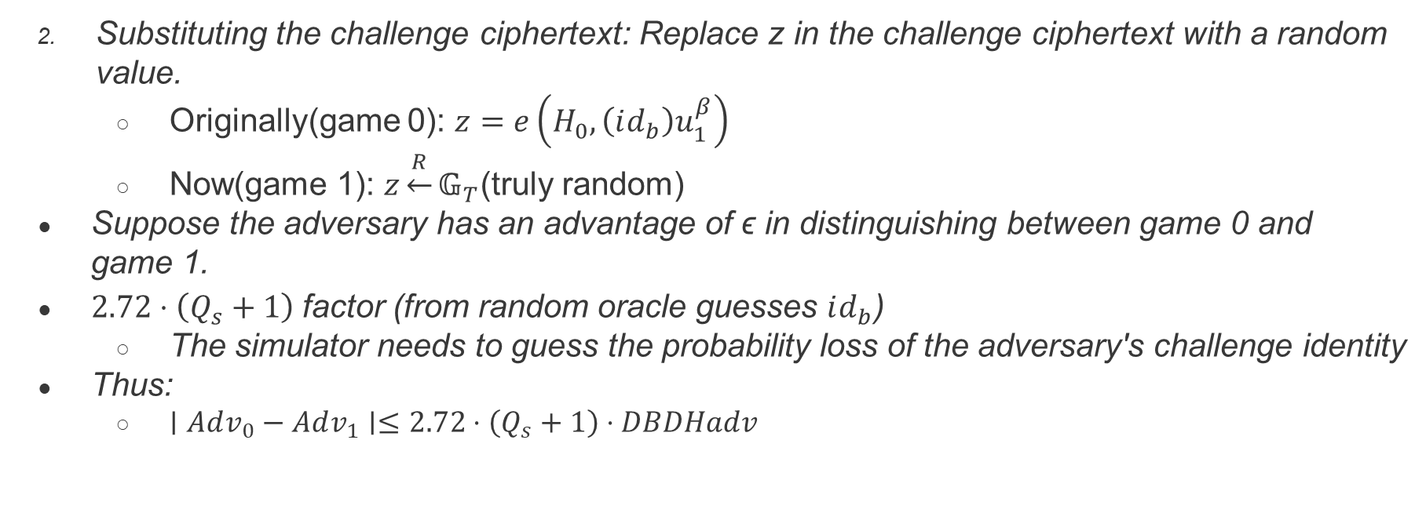
Identity based encryption from pairings ───Construction 1 ─── Proof
Substituting the challenge ciphertext: Replace z in the challenge ciphertext with a random value.
  Originally(game 0): $z=e\left(H_{0},\left(id_{b}\right)u_{1}^{β}\right)$
  Now(game 1): $z\underset{←}{R}𝔾_{T}$(truly random)
Suppose the adversary has an advantage of ϵ in distinguishing between game 0 and game 1.
$2.72⋅\left(Q_{s}​+1\right)$factor (from random oracle guesses $id_{b}$)
  The simulator needs to guess the probability loss of the adversary's challenge identity
Thus:
  $∣Adv_{0}​−Adv_{1}​∣≤2.72⋅\left(Q_{s}​+1\right)⋅DBDHadv$

Slide 22
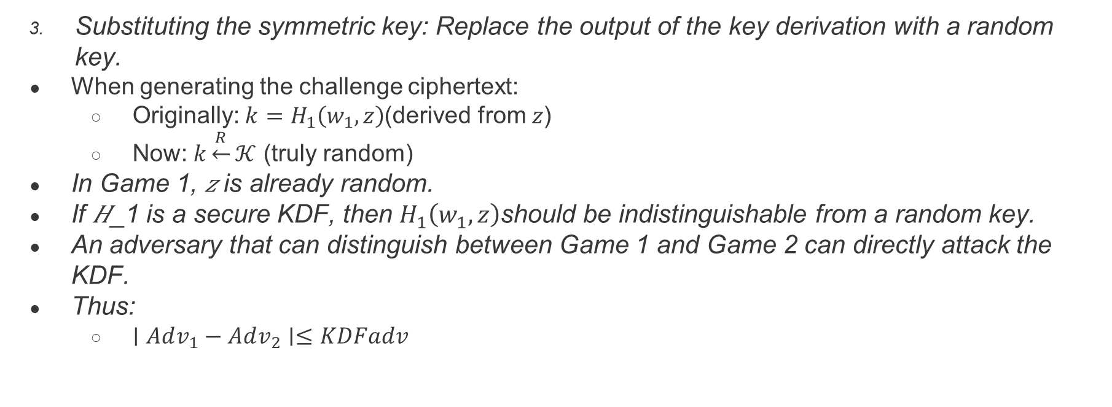
Identity based encryption from pairings ───Construction 1 ─── Proof
Substituting the symmetric key: Replace the output of the key derivation with a random key.
When generating the challenge ciphertext:
  Originally: $k=H_{1}\left(w_{1},z\right)$(derived from 𝑧)
  Now: $k\underset{←}{R}𝒦$ (truly random)
In Game 1, 𝑧 is already random.
If 𝐻_1 is a secure KDF, then $H_{1}\left(w_{1},z\right)$should be indistinguishable from a random key.
An adversary that can distinguish between Game 1 and Game 2 can directly attack the KDF.
Thus:
  $∣Adv_{1}​−Adv_{2}​∣≤KDFadv$

Slide 23
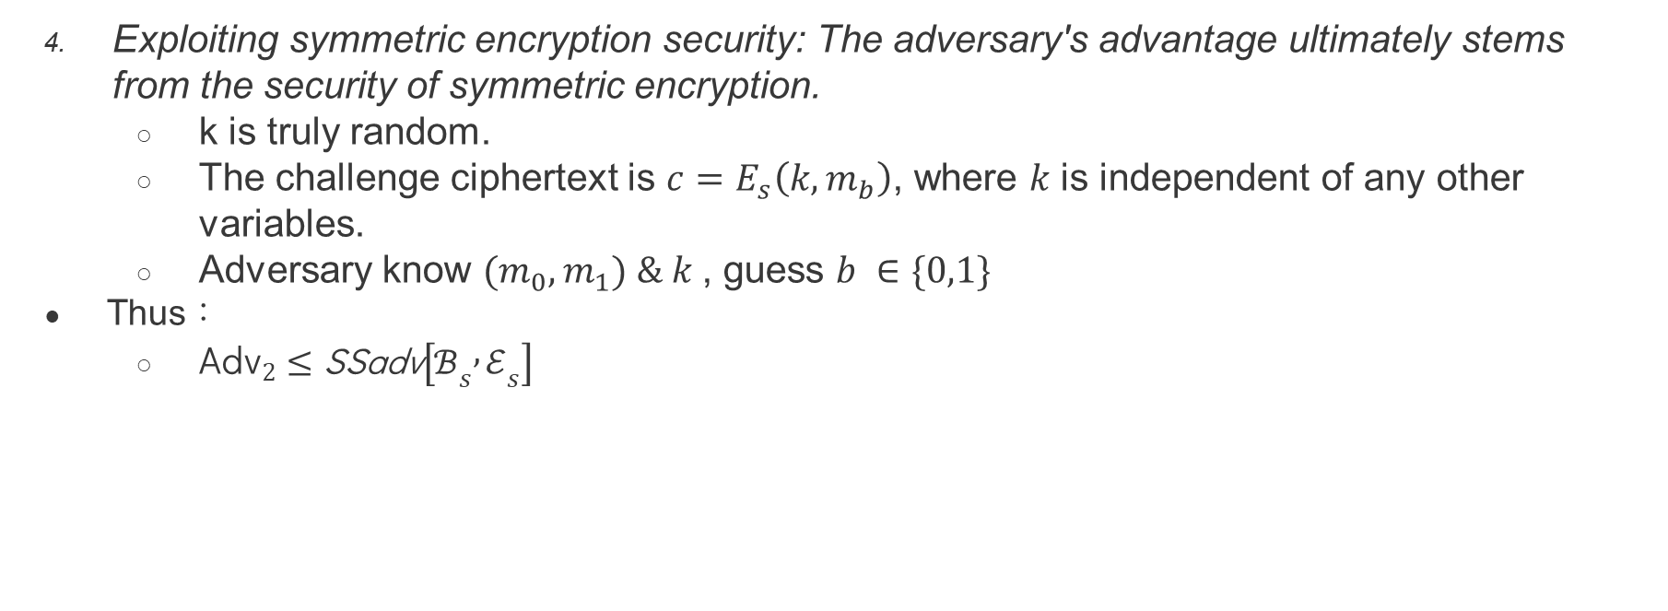
Identity based encryption from pairings ───Construction 1 ─── Proof
Exploiting symmetric encryption security: The adversary's advantage ultimately stems from the security of symmetric encryption.
  k is truly random.
  The challenge ciphertext is $c=E_{s}\left(k,m_{b}\right)$, where 𝑘 is independent of any other variables.
  Adversary know $(m_{0},m_{1}) \& k$, guess $b ∈\{0,1\}$
Thus：
  ${\text{Adv}}_{2}≤\text{SSadv}\left[ℬ_{s} , ℰ_{s}\right]$

Slide 24
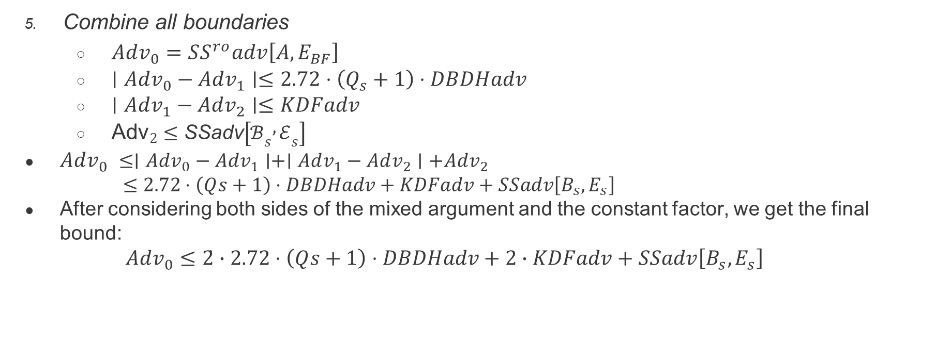
Identity based encryption from pairings ───Construction 1 ─── Proof
Combine all boundaries
  $Adv_{0}​=SS^{ro}adv\left[A,E_{BF}​\right]$
  $∣Adv_{0}​−Adv_{1}​∣≤2.72⋅\left(Q_{s}​+1\right)⋅DBDHadv$
  $∣Adv_{1}​−Adv_{2}​∣≤KDFadv$
  ${\text{Adv}}_{2}≤\text{SSadv}\left[ℬ_{s} , ℰ_{s}\right]$
$Adv_{0} ​​≤∣Adv_{0}​−Adv_{1}​∣+∣Adv_{1}​−Adv_{2}​∣+Adv_{2}​$
$≤2.72⋅\left(Qs_{​}+1\right)⋅DBDHadv+KDFadv+SSadv\left[B_{s}​,E_{s}​\right]​$
After considering both sides of the mixed argument and the constant factor, we get the final bound:
$Adv_{0}≤2̇∙2.72⋅\left(Qs_{​}+1\right)⋅DBDHadv+2∙KDFadv+SSadv\left[B_{s}​,E_{s}​\right]​$

Slide 25
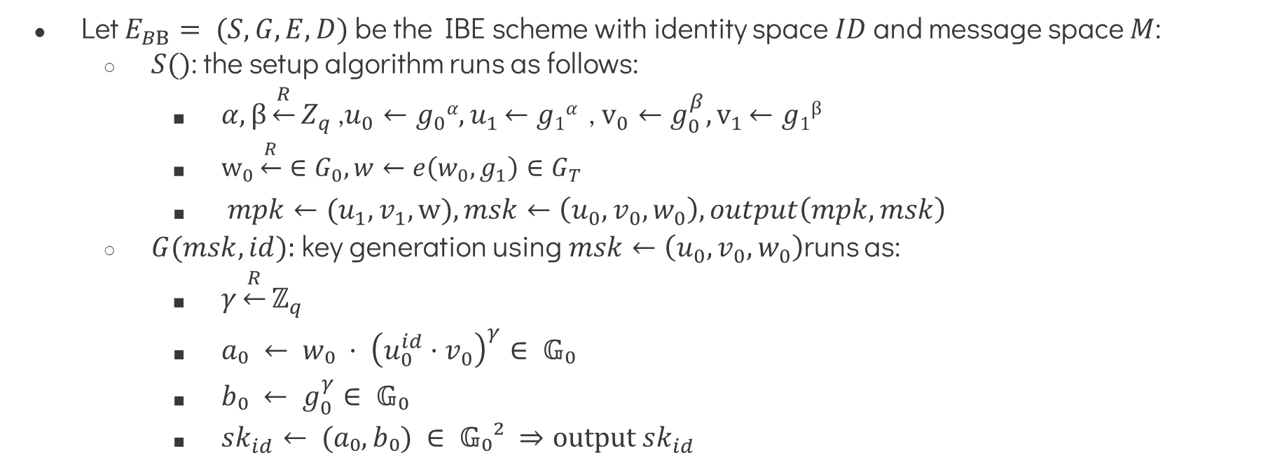
Identity based encryption from pairings ───Construction 2
Let $E_{BB}= (S, G, E, D)$be the IBE scheme with identity space $ID$ and message space $M$:
  $S()$: the setup algorithm runs as follows:
    $α,β\underset{←}{R}Z_{q}$ ,$u_{0}←g_{0}α{,u}_{1}←g1α$ , $v_{0}←g_{0}^{β}{,v}_{1}←g1β$
    $w_{0}\underset{←}{R}∈G_{0},w←e\left(w_{0},g_{1}\right)∈G_{T}$
    $mpk←(u_{1},v_{1},w),msk←\left(u_{0},v_{0},w_{0}\right),output\left(mpk,msk\right)$
  $G(msk, id):$key generation using$msk←\left(u_{0},v_{0},w_{0}\right)$runs as:

Slide 26
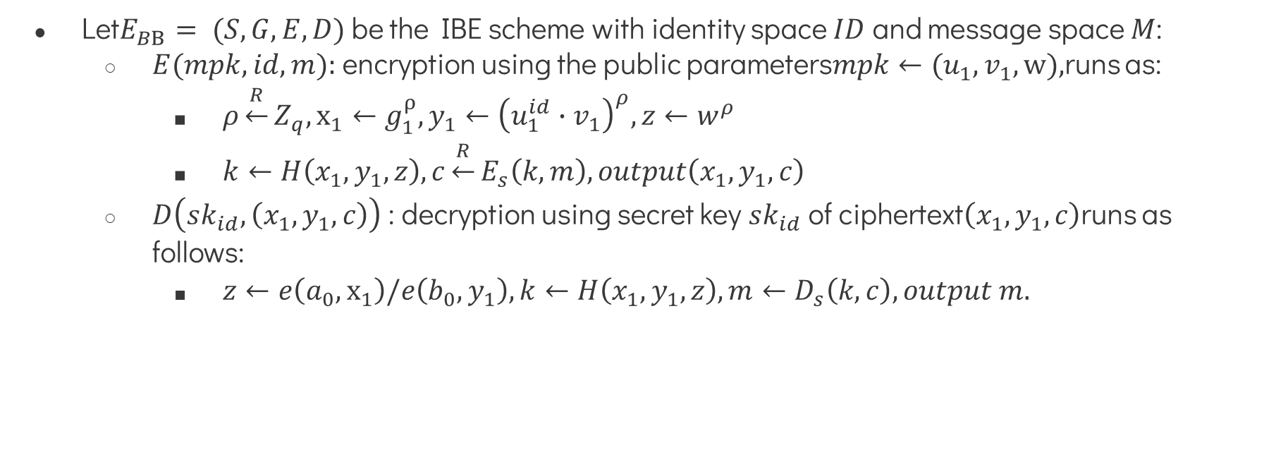
Identity based encryption from pairings ───Construction 2
Let$E_{BB}= (S, G, E, D)$be the IBE scheme with identity space $ID$ and message space $M$:
  $E(mpk, id, m):$encryption using the public parameters$mpk←(u_{1},v_{1},w),$runs as:
    $ρ\underset{←}{R}Z_{q},x_{1}←g_{1}^{ρ},y_{1}←{\left(u_{1}^{id}∙v_{1}\right)}^{ρ},z←w^{ρ}​$
    $k←H\left(x_{1},y_{1},z\right),c\underset{←}{R}E_{s}\left(k,m\right),output\left(x_{1},y_{1},c\right)$
  $D\left(sk_{id},\left(x_{1},y_{1},c\right)\right)$ : decryption using secret key $sk_{id}$ of ciphertext$\left(x_{1},y_{1},c\right)$runs as follows:
    $z←e\left(a_{0},x_{1}\right)/e\left(b_{0},y_{1}\right),k←H\left(x_{1},y_{1},z\right),m←D_{s}\left(k,c\right),output m.$

Slide 27
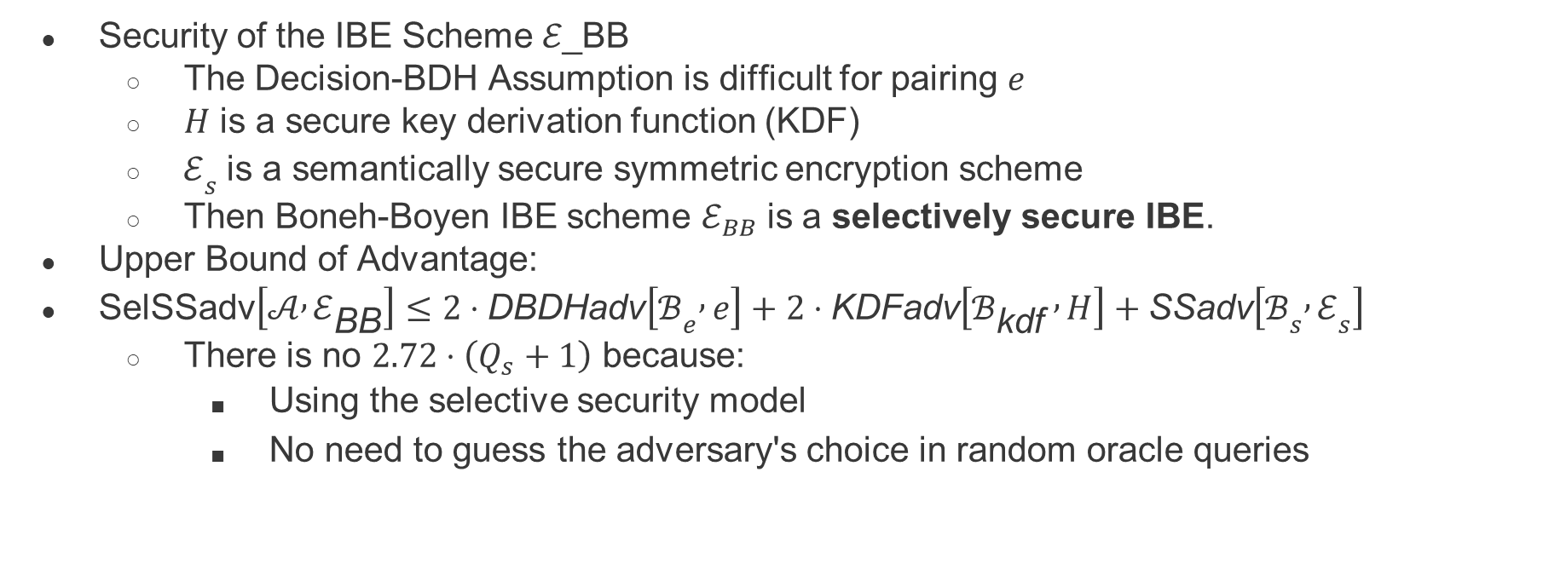
Identity based encryption from pairings ───Construction 2
Security of the IBE Scheme ℰ_BB
  The Decision-BDH Assumption is difficult for pairing $e$
  $H$ is a secure key derivation function (KDF)
  $ℰ_{s}$ is a semantically secure symmetric encryption scheme
  Then Boneh-Boyen IBE scheme $ℰ_{BB}$is a selectively secure IBE.
Upper Bound of Advantage:
$\text{SelSSadv}\left[𝒜 , ℰ_{\text{BB}}\right]≤2⋅\text{DBDHadv}\left[ℬ_{e} , e\right]+2⋅\text{KDFadv}\left[ℬ_{\text{kdf}} , H\right]+\text{SSadv}\left[ℬ_{s} , ℰ_{s}\right]$
  There is no $2.72⋅\left(Q_{s}+1\right)$ because:
    Using the selective security model
    No need to guess the adversary's choice in random oracle queries

Slide 28
Applications
In this section will intro:
  Chosen ciphertext security from IBE
  Signatures from IBE
  Searching on public-key encrypted data

Slide 29
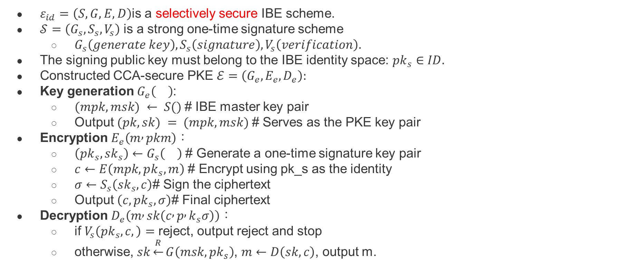
Applications──Chosen ciphertext security from IBE
$ε_{id}=\left(S,G,E,D\right)$is a selectively secure IBE scheme.
$𝒮=\left(G_{s},S_{s},V_{s}\right)$ is a strong one-time signature scheme
  $G_{s}\left(generate key\right),S_{s}\left(signature\right),V_{s}\left(verification\right).$
The signing public key must belong to the IBE identity space: $pk_{s}∈ID.$
Constructed CCA-secure PKE $ℰ=\left(G_{e},E_{e},D_{e}\right):$
Key generation $G_{e}\left(\right)$:
  $(mpk, msk) ← S()$# IBE master key pair
  Output $(pk, sk) = (mpk, msk)$# Serves as the PKE key pair
Encryption $E_{e}\left(m , pkm\right)$：
  $\left(pk_{s},sk_{s}\right)←G_{s}\left(\right)$ # Generate a one-time signature key pair
  $c←E\left(mpk,pk_{s},m\right)$ # Encrypt using pk_s as the identity
  $σ←S_{s}\left(sk_{s},c\right)$# Sign the ciphertext
  Output $\left(c,pk_{s},σ\right)$# Final ciphertext
Decryption $D_{e}\left(m , sk\left(c , p , k_{s}σ\right)\right)$：
  if $V_{s}\left(pk_{s},c,\right)=$ reject, output reject and stop
  otherwise, $sk\underset{←}{R}G\left(msk,pk_{s}\right)$, $m←D\left(sk,c\right)$, output m.

Slide 30
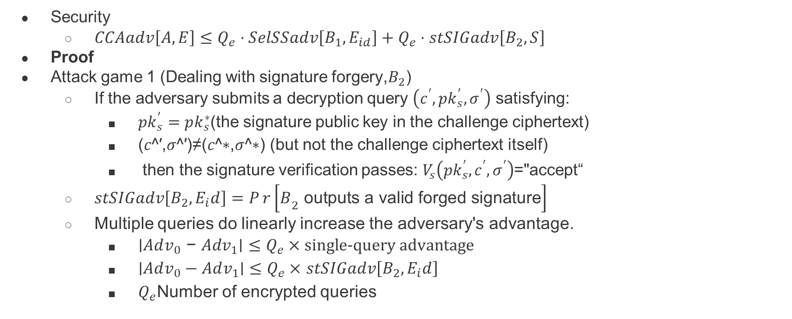
Applications──Chosen ciphertext security from IBE
Security
  $CCAadv\left[A,E\right]≤Q_{e}​⋅SelSSadv\left[B_{1}​,E_{id}​\right]+Q_{e}​⋅stSIGadv\left[B_{2}​,S\right]$
Proof
Attack game 1 (Dealing with signature forgery,$B_{2}$)
  If the adversary submits a decryption query $\left(c^{′},pk_{s}^{′},σ^{′}\right)$ satisfying:
    $pk_{s}^{′}=pk_{s}^{∗}$(the signature public key in the challenge ciphertext)
    (𝑐^′,𝜎^′)≠(𝑐^∗,𝜎^∗) (but not the challenge ciphertext itself)
    then the signature verification passes: $V_{s}\left(pk_{s}^{′},c^{′},σ^{′}\right)$="accept“
  $stSIGadv\left[B_{2}​,E_{i}d\right]=Pr\left[B_{2 }\text{outputs} \text{a} \text{valid} \text{forged} \text{signature}\right]$
  Multiple queries do linearly increase the adversary's advantage.
    $\text{∣}Adv_{0}\text{​} \text{−} Adv_{1}\text{​∣}≤Q_{e}×\text{single}\text{−}\text{query} \text{advantage}$
    $\text{∣}Adv_{0}​−Adv_{1}\text{​∣}≤Q_{e}×$ $stSIGadv\left[B_{2}​,E_{i}d\right]$
    $Q_{e}$Number of encrypted queries

Slide 31
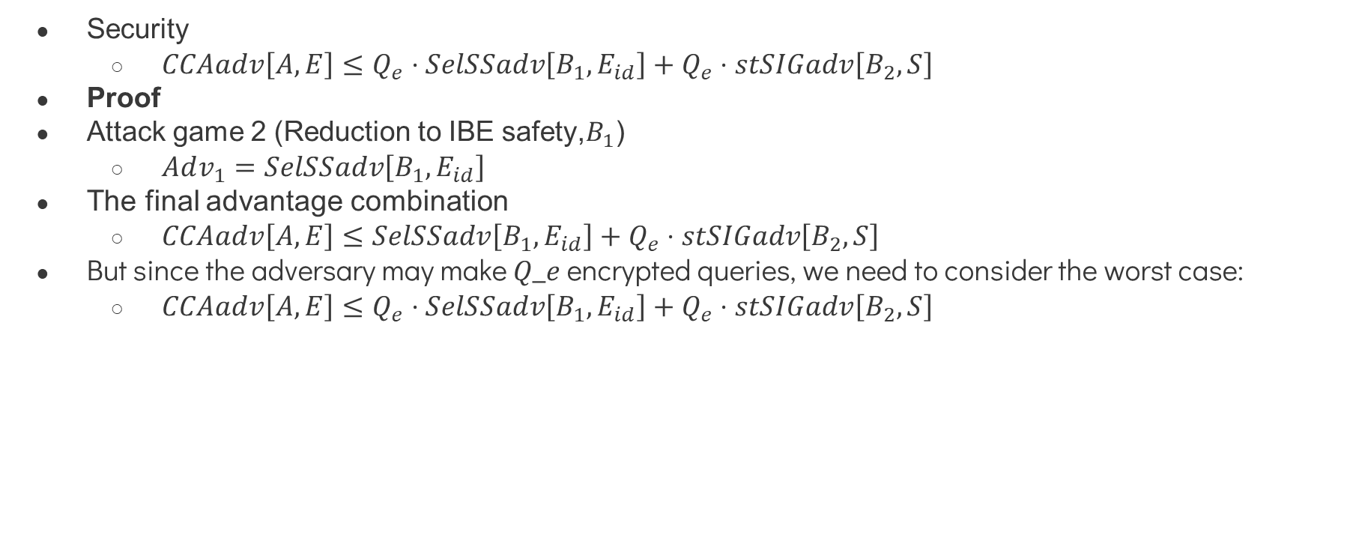
Applications──Chosen ciphertext security from IBE
Security
  $CCAadv\left[A,E\right]≤Q_{e}​⋅SelSSadv\left[B_{1}​,E_{id}​\right]+Q_{e}​⋅stSIGadv\left[B_{2}​,S\right]$
Proof
Attack game 2 (Reduction to IBE safety,$B_{1}$)
  $Adv_{1}​=SelSSadv\left[B_{1}​,E_{id}​\right]$
The final advantage combination
  $CCAadv\left[A,E\right]≤SelSSadv\left[B_{1}​,E_{id}​\right]+Q_{e}​⋅stSIGadv\left[B_{2}​,S\right]$
But since the adversary may make 𝑄_𝑒 encrypted queries, we need to consider the worst case:
  $CCAadv\left[A,E\right]≤Q_{e}​⋅SelSSadv\left[B_{1}​,E_{id}​\right]+Q_{e}​⋅stSIGadv\left[B_{2}​,S\right]$

Slide 32
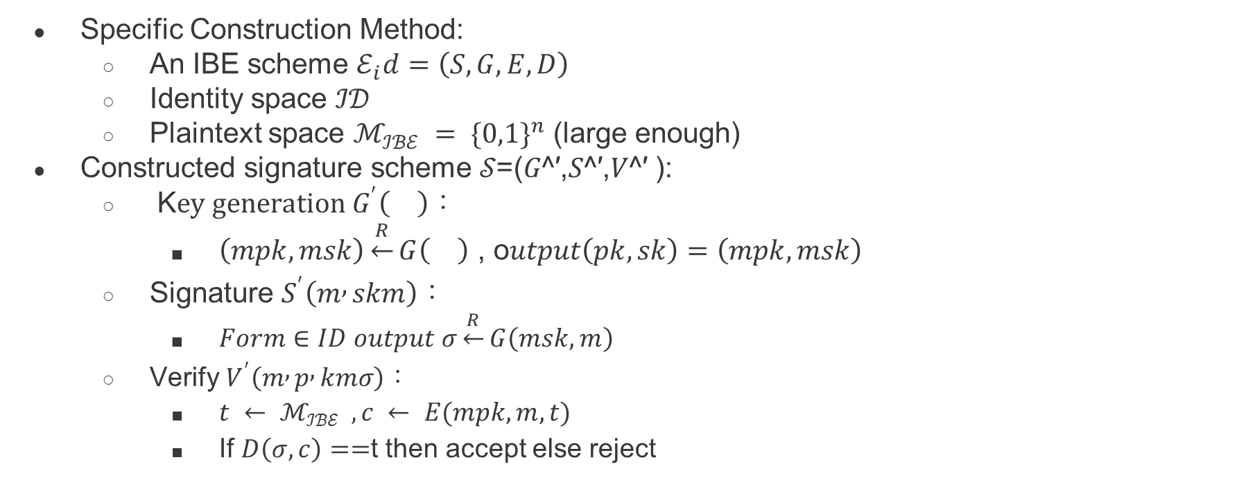
Applications──Signatures from IBE
Specific Construction Method:
  An IBE scheme $ℰ_{i}d=\left(S,G,E,D\right)$
  Identity space ℐ𝒟
  Plaintext space $ℳ_{ℐℬℰ} = {\{0,1\}}^{n}$ (large enough)
Constructed signature scheme 𝒮=(𝐺^′,𝑆^′,𝑉^′ ):
  K$ey generation G^{′}\left(\right)$：
    $\left(mpk,msk\right)\underset{←}{R}G\left(\right) \text{, }\text{o}utput\left(pk,sk\right)=\left(mpk,msk\right)$
  Signature $S^{′}\left(m , skm\right)$：
    $Form∈ID output σ\underset{←}{R}G\left(msk,m\right)$
  Verify $V^{′}\left(m , p , kmσ\right)$：
    $t ← ℳ_{ℐℬℰ} ,c ← E(mpk, m, t)$
    If $D\left(σ,c\right)==$t then accept else reject

Slide 33
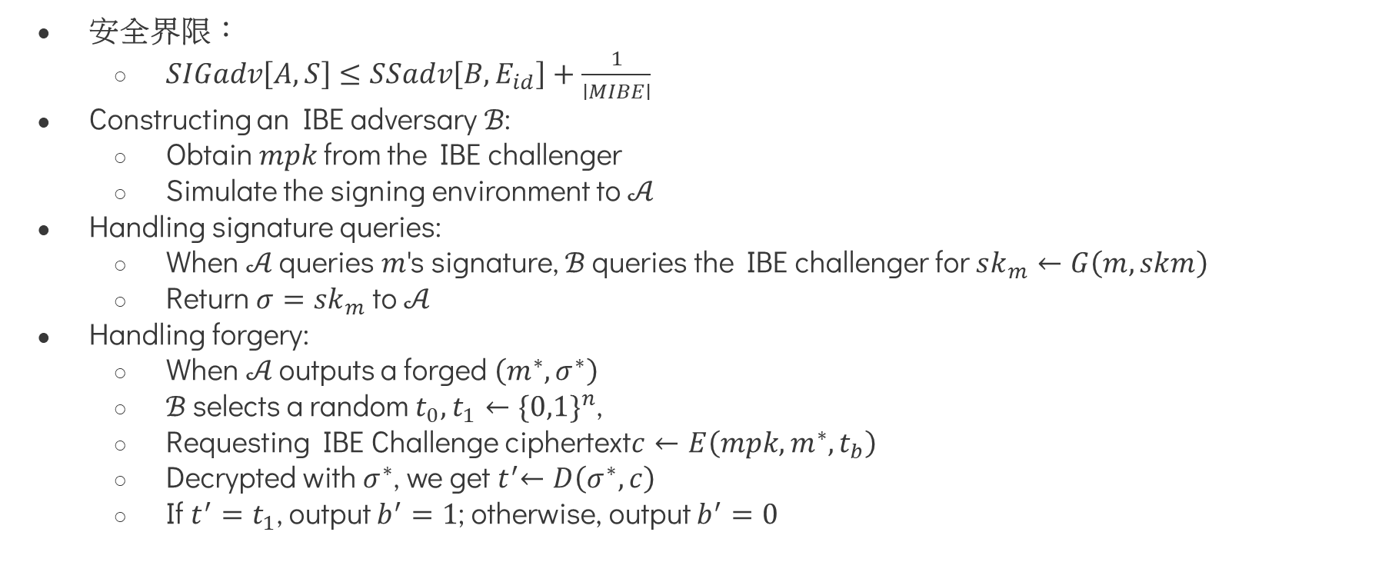
Applications──Signatures from IBE
安全界限：
  $SIGadv\left[A,S\right]≤SSadv\left[B,E_{id}​\right]+\frac{1}{∣MIBE​∣}$
Constructing an IBE adversary ℬ:
  Obtain 𝑚𝑝𝑘 from the IBE challenger
  Simulate the signing environment to 𝒜
Handling signature queries:
  When 𝒜 queries 𝑚's signature, ℬ queries the IBE challenger for $sk_{m}←G\left(m,skm\right)$
  Return $σ=sk_{m}$ to 𝒜
Handling forgery:
  When 𝒜 outputs a forged $\left(m^{∗},σ^{∗}\right)$
  ℬ selects a random $t_{0},t_{1}←{\{0,1\}}^{n}$,
  Requesting IBE Challenge ciphertext$c←E\left(mpk,m^{∗},t_{b}\right)$
  Decrypted with $σ^{∗}$, we get${ t}^{′}←D\left(σ^{∗},c\right)$
  If $t^{′}=t_{1}$, output $b^{′}=1$; otherwise, output $b^{′}=0$

Slide 34
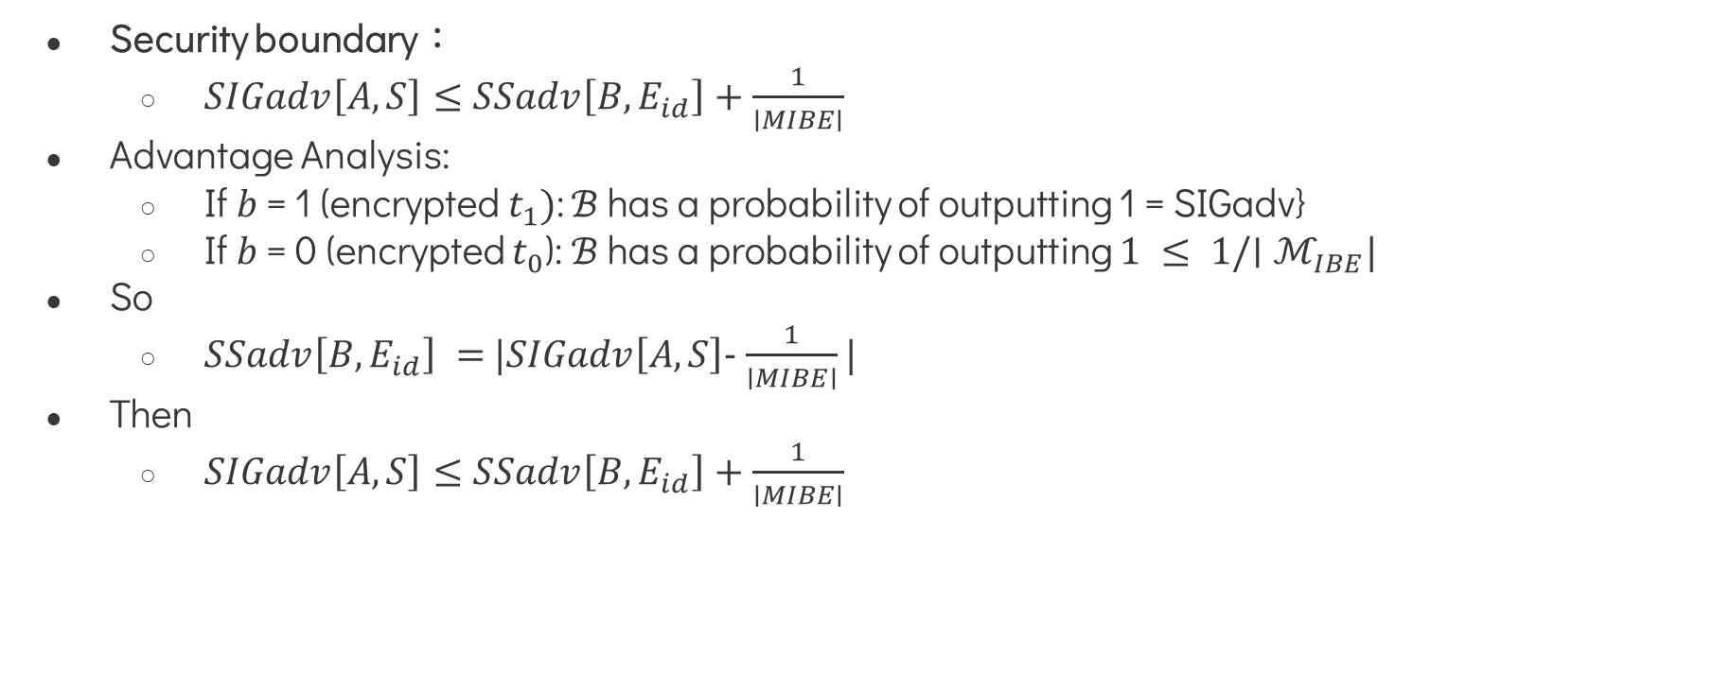
Applications──Signatures from IBE
Security boundary：
  $SIGadv\left[A,S\right]≤SSadv\left[B,E_{id}​\right]+\frac{1}{∣MIBE​∣}$
Advantage Analysis:
  If 𝑏 = 1 (encrypted $t_{1})$: ℬ has a probability of outputting 1 = SIGadv}
  If 𝑏 = 0 (encrypted $t_{0}$): ℬ has a probability of outputting $1 ≤ 1/∣ℳ_{IBE}|$
So
  $SSadv\left[B,E_{id}​\right] =$ $|SIGadv\left[A,S\right]-$ $\frac{1}{∣MIBE​∣}|$
Then
  $SIGadv\left[A,S\right]≤SSadv\left[B,E_{id}​\right]+\frac{1}{∣MIBE​∣}$

Slide 35
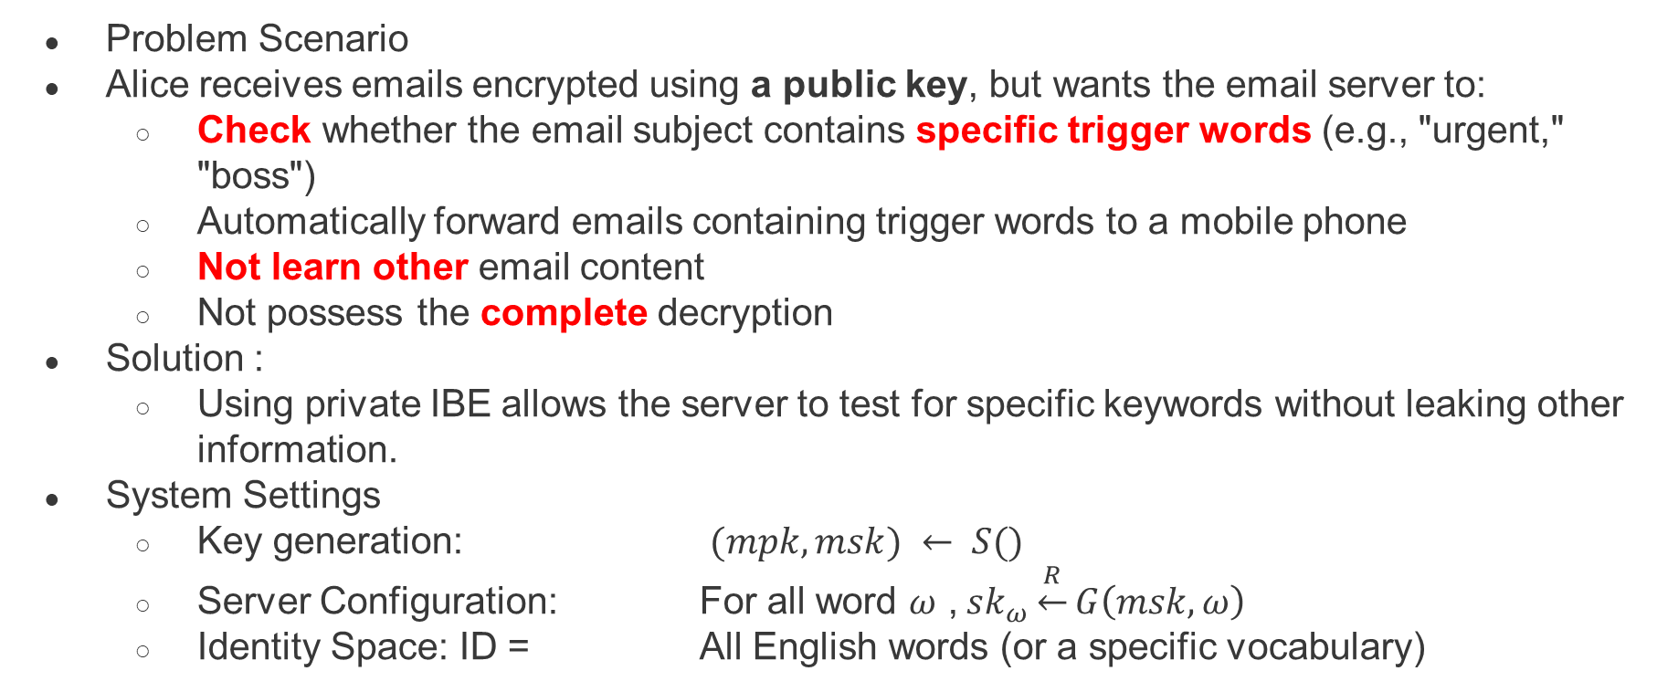
Applications──Searching on public-key encrypted data
Problem Scenario
Alice receives emails encrypted using a public key, but wants the email server to:
  Check whether the email subject contains specific trigger words (e.g., "urgent," "boss")
  Automatically forward emails containing trigger words to a mobile phone
  Not learn other email content
  Not possess the complete decryption
Solution :
  Using private IBE allows the server to test for specific keywords without leaking other information.
System Settings
  Key generation: $(mpk, msk) ← S()$
  Server Configuration: For all word $ω$ , $sk_{ω}\underset{←}{R}G\left(msk,ω\right)$
  Identity Space: ID = All English words (or a specific vocabulary)

Slide 36
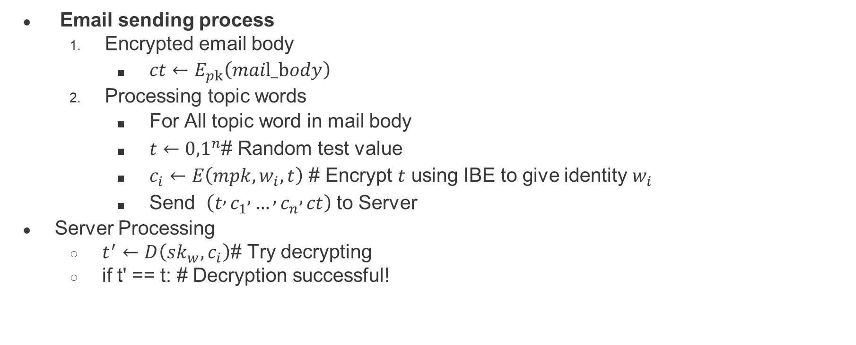
Applications──Searching on public-key encrypted data
Email sending process
  Encrypted email body
    $ct←E_{pk}\left(mail_body\right)$
  Processing topic words
    For All topic word in mail body
    $t←{0,1}^{n}$# Random test value
    $c_{i}←E\left(mpk,w_{i},t\right)$ # Encrypt $t$ using IBE to give identity $w_{i}$
    Send $\left(t , c_{1} , … , c_{n} , ct\right)$ to Server
Server Processing
  $t^{′}←D\left(sk_{w},c_{i}\right)$# Try decrypting
  if t' == t: # Decryption successful!

Slide 37
The functional encryption paradigm

Slide 38
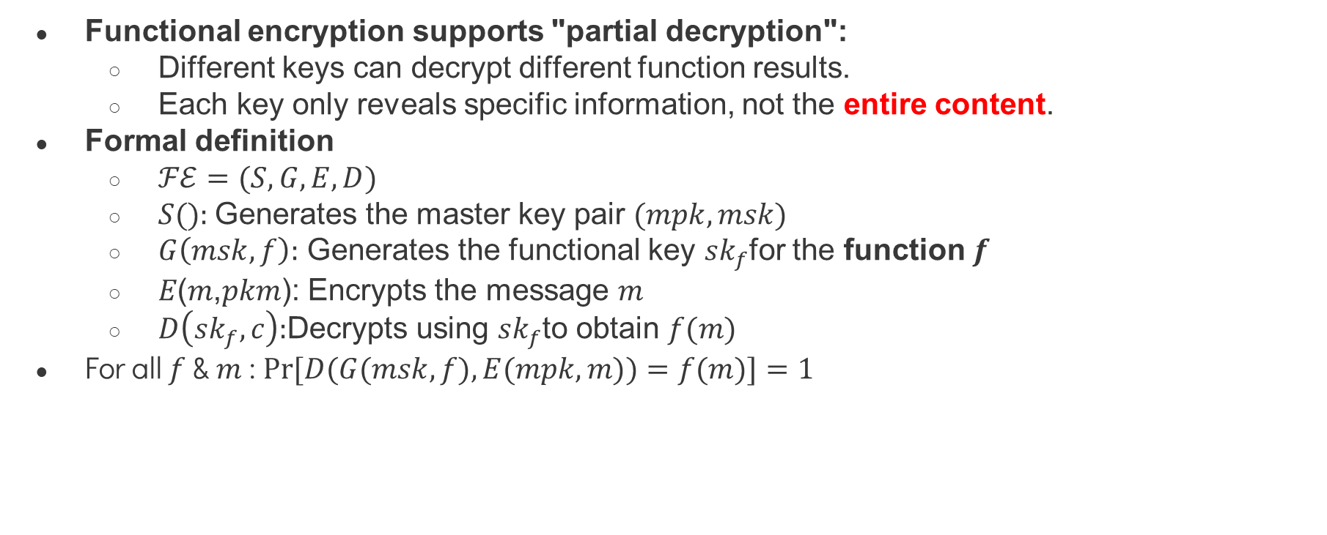
The functional encryption paradigm
Functional encryption supports "partial decryption":
  Different keys can decrypt different function results.
  Each key only reveals specific information, not the entire content.
Formal definition
  $ℱℰ=(S,G,E,D)$
  $S():$Generates the master key pair $(mpk,msk)$
  $G\left(msk,f\right):$ Generates the functional key $sk_{f}$for the function $f$
  𝐸(𝑚,𝑝𝑘𝑚): Encrypts the message $m$
  $D\left(sk_{f},c\right):$Decrypts using $sk_{f}$to obtain $f(m)$
For all $f$ & $m$ : $Pr⁡[D(G(msk,f),E(mpk,m))=f(m)]=1$
Notes:
功能性加密的突破
功能性加密支援 「部分解密」：
不同金鑰可以解密出不同的函數結果
每個金鑰只揭露特定資訊，而非全部內容

Slide 39
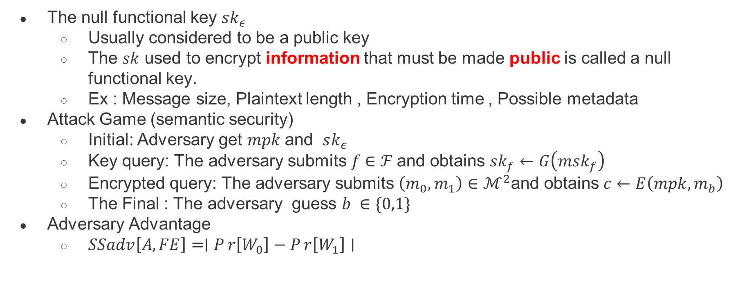
The functional encryption paradigm
The null functional key $sk_{ε}$
  Usually considered to be a public key
  The $sk$ used to encrypt information that must be made public is called a null functional key.
  Ex : Message size, Plaintext length , Encryption time , Possible metadata
Attack Game (semantic security)
  Initial: Adversary get 𝑚𝑝𝑘 and $sk_{ε}$
  Key query: The adversary submits 𝑓 ∈ ℱ and obtains $sk_{f}←G\left(msk_{f}\right)$
  Encrypted query: The adversary submits $\left(m_{0},m_{1}\right)∈ℳ^{2}$and obtains $c←E\left(mpk,m_{b}\right)$
  The Final : The adversary guess $b ∈\{0,1\}$
Adversary Advantage
  $SSadv\left[A,FE\right]=∣Pr\left[W_{0}​\right]−Pr\left[W_{1}​\right]∣$
Notes:
空白功能金鑰 𝑠𝑘_𝜖
通常被認為是公鑰
用於加密必須公開的資訊的密鑰稱為空功能密鑰。
例如：訊息大小、明文長度、加密時間、可能的元數據
攻擊博弈（語意安全）
初始：對手取得𝑚𝑝𝑘 𝑠𝑘_𝜖
金鑰查詢：對手提交𝑓 ∈ ℱ 並取得𝑠𝑘_𝑓←𝐺(𝑚𝑠𝑘_𝑓)
加密查詢：對手提交 (𝑚_0,𝑚_1)∈ℳ^2 並取得𝑐←𝐸(𝑚𝑝𝑘,𝑚_𝑏)
最終：對手猜測𝑏 ∈\{0,1\}
對手優勢
𝑆𝑆𝑎𝑑𝑣[𝐴,𝐹𝐸]=∣𝑃 𝑟⁡[𝑊_0 ]−𝑃 𝑟⁡[𝑊_1 ]∣

Slide 40
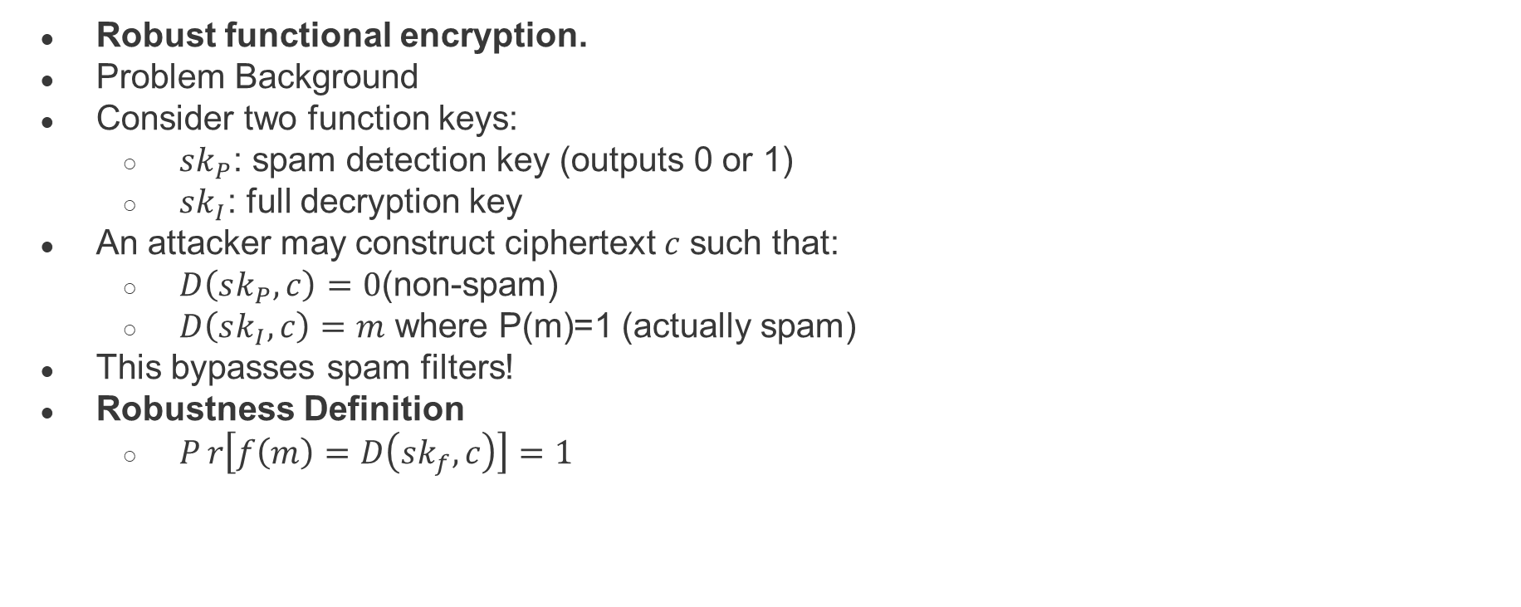
The functional encryption paradigm
Robust functional encryption.
Problem Background
Consider two function keys:
  $sk_{P}$: spam detection key (outputs 0 or 1)
  $sk_{I}$: full decryption key
An attacker may construct ciphertext 𝑐 such that:
  $D\left(sk_{P}​,c\right)=0$(non-spam)
  $D\left(sk_{I},c\right)=m \text{where} \text{P}\text{(}\text{m}\text{)=}\text{1}$ (actually spam)
This bypasses spam filters!
Robustness Definition
  $Pr\left[f\left(m\right)=D\left(sk_{f}​,c\right)\right]=1$
Notes:
魯棒函數加密。
問題背景
考慮兩個函數密鑰：
𝑠𝑘_𝑃：垃圾郵件偵測金鑰（輸出 0 或 1）
𝑠𝑘_𝐼：完整解密金鑰
攻擊者可以構造密文 𝑐，使得：
𝐷(𝑠𝑘_𝑃 ,𝑐)=0（非垃圾郵件）
𝐷(𝑠𝑘_𝐼,𝑐)=𝑚"，其中 P(m)=1"（實際為垃圾郵件）
這可以繞過垃圾郵件過濾器！
穩健性定義
𝑃 𝑟⁡[𝑓(𝑚)=𝐷(𝑠𝑘_𝑓 ,𝑐)]=1

Slide 41
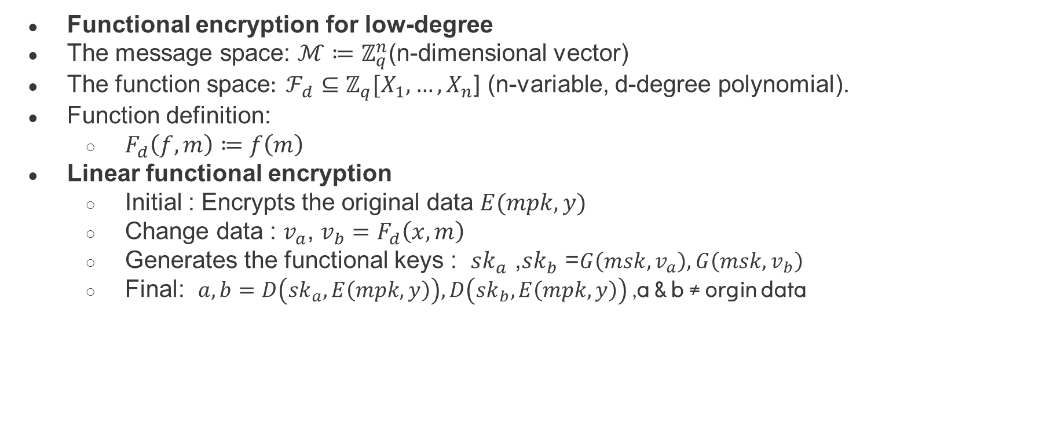
Sample functional encryption schemes from pairings
Functional encryption for low-degree
The message space: $ℳ≔ℤ_{q}^{n}$(n-dimensional vector)
The function space$: ℱ_{d}⊆ℤ_{q}[X_{1},…,X_{n}$] (n-variable, d-degree polynomial).
Function definition:
  $F_{d}\left(f,m\right)≔f\left(m\right)$
Linear functional encryption
  Initial : Encrypts the original data $E(mpk, y)$
  Change data : $v_{a}$, $v_{b}=F_{d}\left(x,m\right)$
  Generates the functional keys : $sk_{a}$ ,$sk_{b}$ =$G\left(msk,v_{a}\right),G\left(msk,v_{b}\right)$
  Final: $a,b=D\left(sk_{a},E\left(mpk,y\right)\right),D\left(sk_{b},E\left(mpk,y\right)\right)$ ,a & b ≠ orgin data

Slide 42
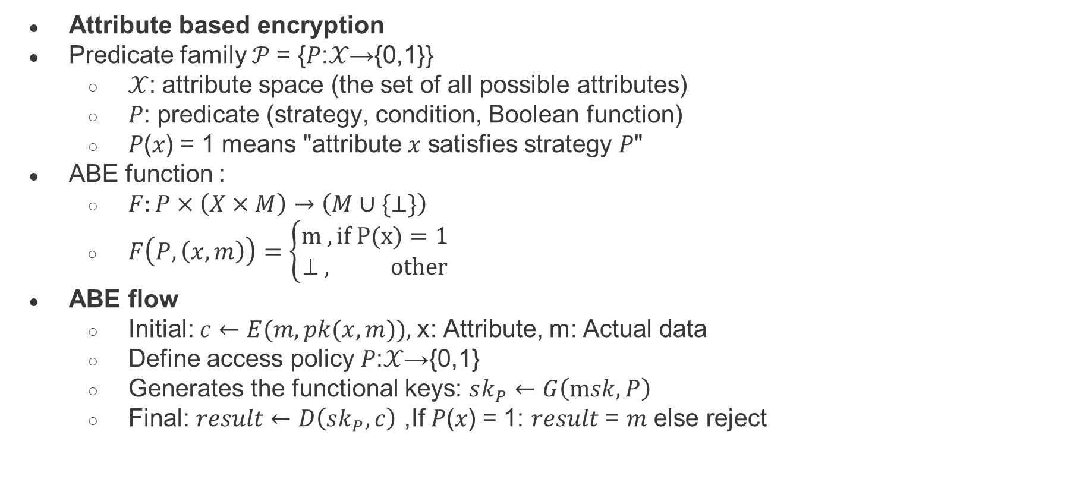
Sample functional encryption schemes from pairings
Attribute based encryption
Predicate family 𝒫 = {𝑃:𝒳→{0,1}}
  𝒳: attribute space (the set of all possible attributes)
  𝑃: predicate (strategy, condition, Boolean function)
  𝑃(𝑥) = 1 means "attribute 𝑥 satisfies strategy 𝑃"
ABE function :
  $F:P×\left(X×M\right)→\left(M∪\{⊥\}\right)$
  $F\left(P,\left(x,m\right)\right)=\left\{\begin{aligned}m ,if P(x)=1 \\ ⊥ , other\end{aligned}\right.​$
ABE flow
  Initial: $c←E(m,pk(x,m)),$x: Attribute, m: Actual data
  Define access policy 𝑃:𝒳→{0,1}
  Generates the functional keys: $sk_{P}←G\left(msk,P\right)$
  Final: $result←D\left(sk_{P},c\right)$ ,If 𝑃(𝑥) = 1: 𝑟𝑒𝑠𝑢𝑙𝑡 = 𝑚 else reject
Notes:
基於屬性的加密
1. 謂詞族 𝒫 = {𝑃:𝒳→{0,1}}
𝒳：屬性空間（所有可能屬性的集合）
𝑃：謂詞（策略、條件、布林函數）
𝑃(𝑥) = 1 表示“屬性 𝑥 滿足策略 𝑃”
ABE 函數：
𝐹:𝑃×(𝑋×𝑀)→(𝑀∪{⊥})
𝐹(𝑃,(𝑥,𝑚))={█(m ,若 P(x)=1@⊥ , 其他)┤
ABE 流
初始值：𝑐←𝐸(𝑚,𝑝𝑘(𝑥,𝑚)), x:屬性，m：實際數據
定義存取策略 𝑃:𝒳→{0,1}
產生功能鍵：𝑠𝑘_𝑃←𝐺(m𝑠𝑘,𝑃)
最終結果：𝑟𝑒𝑠𝑢𝑙𝑡←𝐷(𝑠𝑘_𝑃,𝑐)，如果 𝑃(𝑥) = 1：𝑟𝑠𝑠𝑠𝑠

Slide 43
Multilinear maps

Slide 44
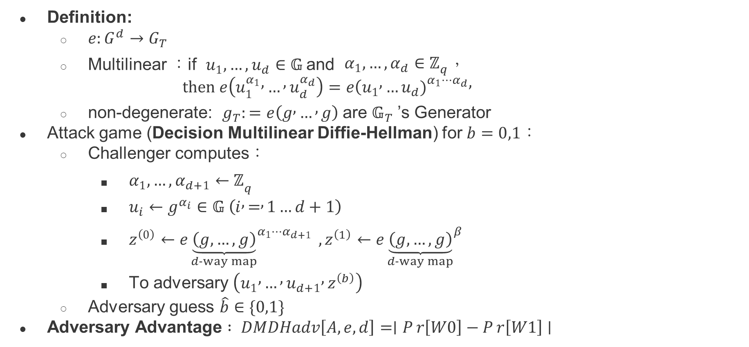
Multilinear maps
Definition:
  $e:G^{d}→G_{T}​$
  Multilinear ：if $u_{1},…,u_{d}∈𝔾$ and $α_{1},…,α_{d}∈ℤ_{q}$，
    $$then e\left(u_{1}^{α_{1}} , … , u_{d}^{α_{d}}\right)=e(u_{1} , …u_{d}{\left.)\right.}^{α_{1}⋯α_{d}},$$
  non-degenerate: $g_{T}:=e\left(g , … , g\right)$ are $𝔾_{T}$ ’s Generator
Attack game (Decision Multilinear Diffie-Hellman) for $b=0,1$：
  Challenger computes：
    $α_{1},…,α_{d+1}←ℤ_{q}$
    $u_{i}←g^{α_{i}}∈𝔾 \left(i , = , 1…d+1\right)$
    $z^{\left(0\right)}←e{\underset{d-way map}{\underbrace{\left(g,…,g\right)}}}^{α_{1}⋯α_{d+1}} ,z^{\left(1\right)}←e{\underset{d-way map}{\underbrace{\left(g,…,g\right)}}}^{β}$
    To adversary $\left(u_{1} , … , u_{d+1} , z^{\left(b\right)}\right)$
  Adversary guess $\hat{b}∈\{0,1\}$
Adversary Advantage $: DMDHadv\left[A,e,d\right]=∣Pr\left[W0​\right]−Pr\left[W1​\right]∣$
Notes:
定義：
𝑒:𝐺^𝑑→𝐺_𝑇
多線性：若 𝑢_1,…,𝑢_𝑑∈𝔾 且 𝛼_1,…,𝛼_𝑑∈ℤ_𝑞，
則 𝑒(𝑢_1^(𝛼_1 )ⓜ,…ⓜ,𝑢_𝑑^(𝛼_𝑑 ) )=𝑒(𝑢_1ⓜ,…𝑢_𝑑 ┝𝑎
非退化： 𝑔_𝑇:=𝑒(𝑔ⓜ,…ⓜ,𝑔) 是 𝔾_𝑇 的產生器
攻擊遊戲（決策多線性Diffie-Hellman）對於 𝑏=0,1：
挑戰者計算：
𝛼_1,…,𝛼_(𝑑+1)←ℤ_𝑞
𝑢_𝑖←𝑔^(𝛼_𝑖 )∈𝔾 (𝑖ⓜ,=ⓜ,1…𝑑+1)
𝑧^((0) )←𝑒⏟((𝑔,…,𝑔) )┬(𝑑-way map)^(𝛼_1⋯𝛼_(𝑑+1) ) ,𝛼_1⋯𝛼_(𝑑+1) ) ,𝑧^((1) ⑝ )┬(𝑑-way map)^𝛽
至對手 (𝑢_1ⓜ,…ⓜ,𝑢_(𝑑+1)ⓜ,𝑧^((𝑏) ) )
對手猜測𝑏 ̂∈{0,1}
對手優勢：𝐷𝑀𝐷𝐻𝑎𝑑𝑣[𝐴,𝑒,𝑑]=∣𝑃​​ 𝑟⁡[𝑊0]−𝑃 𝑟⁡[𝑊0]−

Slide 45
Thank you for listening

